Slide 1
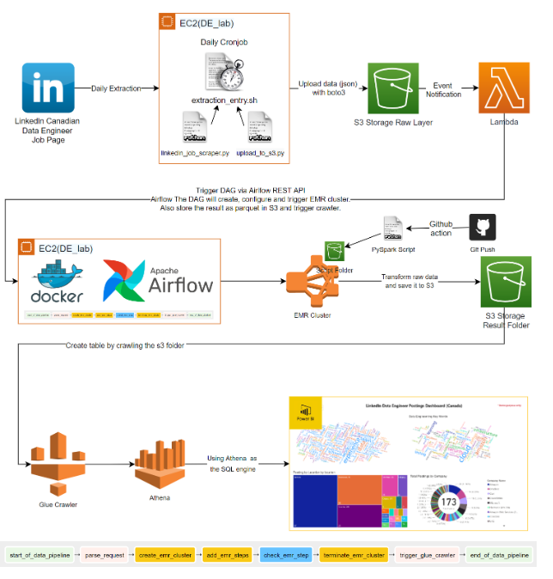
Linkedln Batch ETL Project
Andi An
June 05, 2022

Slide 2
Agenda
Key Topics | Duration
Introduction | 2 mins
Architecture | 5 mins
Demo | 5 mins
Future Improvements | 3 mins
Objectives are to:
Introduce the project architecture
Demonstrate functionalities live
Review the potential future improvement
Desired outcomes are to:
Showcase projects

Slide 3
Introduction
Objective
The goal of this project is to build a data pipeline to extract and transform Canadian data engineering job postings from LinkedIn. The final output of this project is an interactive PowerBI dashboard, which provides an overview of trends in the Canadian data engineering job market.
Motivation
The motivation of the project was based on an interest in understanding various trends in the data engineering jobs market and how they evolve.
Project Consideration
This project also provides an excellent opportunity to develop skills and experience in a range of tools. As such, the project is more complex than required, utilizing airflow, docker, and a series of AWS technology (S3, EC2,Glue,Athena, lambda).

Slide 4
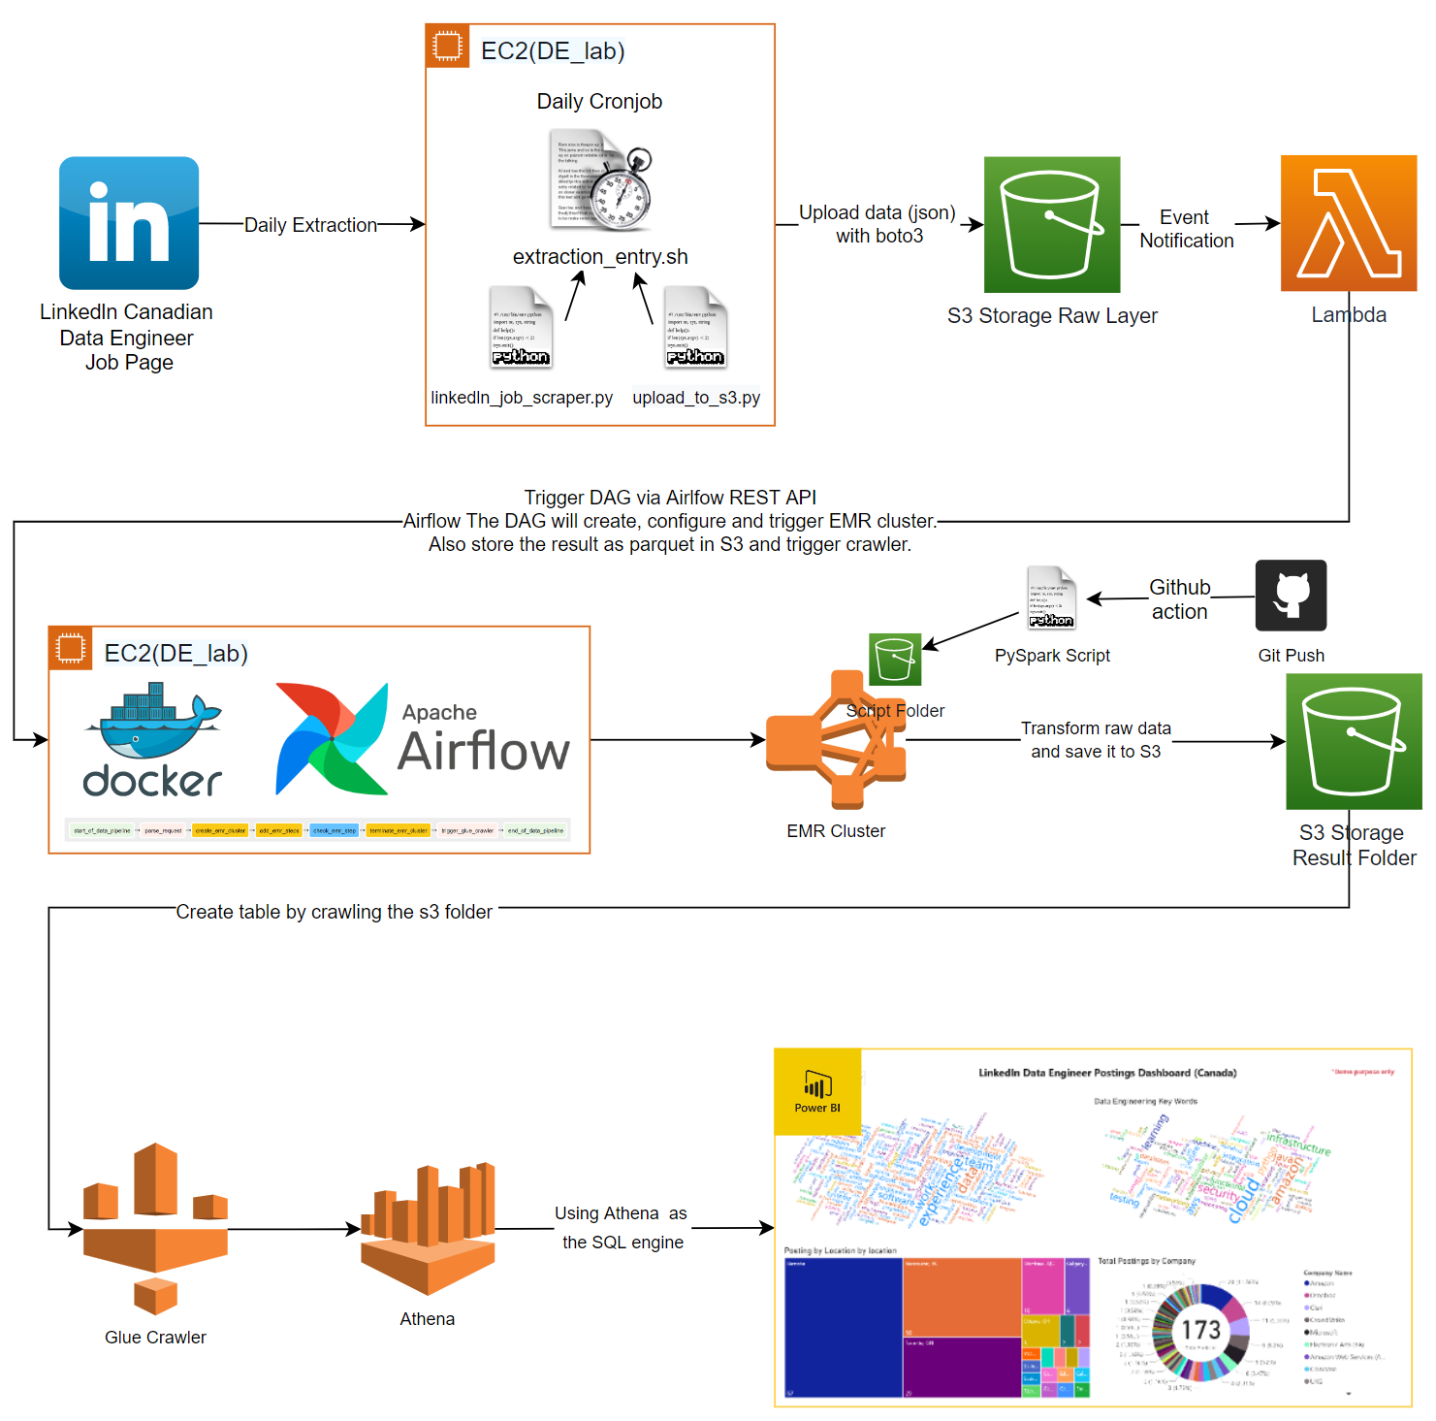
Pipeline Architecture
Components
Data Publisher
The architecture of this project is designed to be event-driven. The pipeline will be triggered once data arrives in S3.
Currently, the data source is a cron job that triggers a shell script which then starts a LinkedIn scraper written in python.
Cloud Storage
A dedicated S3 bucket is used as the cloud storage. There are 3 different folders in this bucket that serves different purposes.
/raw is where the raw data will land in. Any put request in this folder will start an event notification to the lambda function
/stg is where the processed data live.
/scripts is where the pyspark script is located. There is also an automated GitHub action setup that uploads the script to this location after each git push.
Orchestration
Airflow is used as the orchestration tool to schedule EMR and glue activity.
Airflow is set up using the EC2 instance and docker-compose.
S3 event notification and lambda function is used to trigger airflow dag via REST API.
Compute resources
EC2 is used to host the data publisher and airflow. The data publisher can be moved in the future.
EMR is used to transform the data once it arrives in /raw.
Glue crawler and Athena are used as the compute engine which powers the dashboard.
Visualization - PowerBI is used for dashboarding

Slide 5
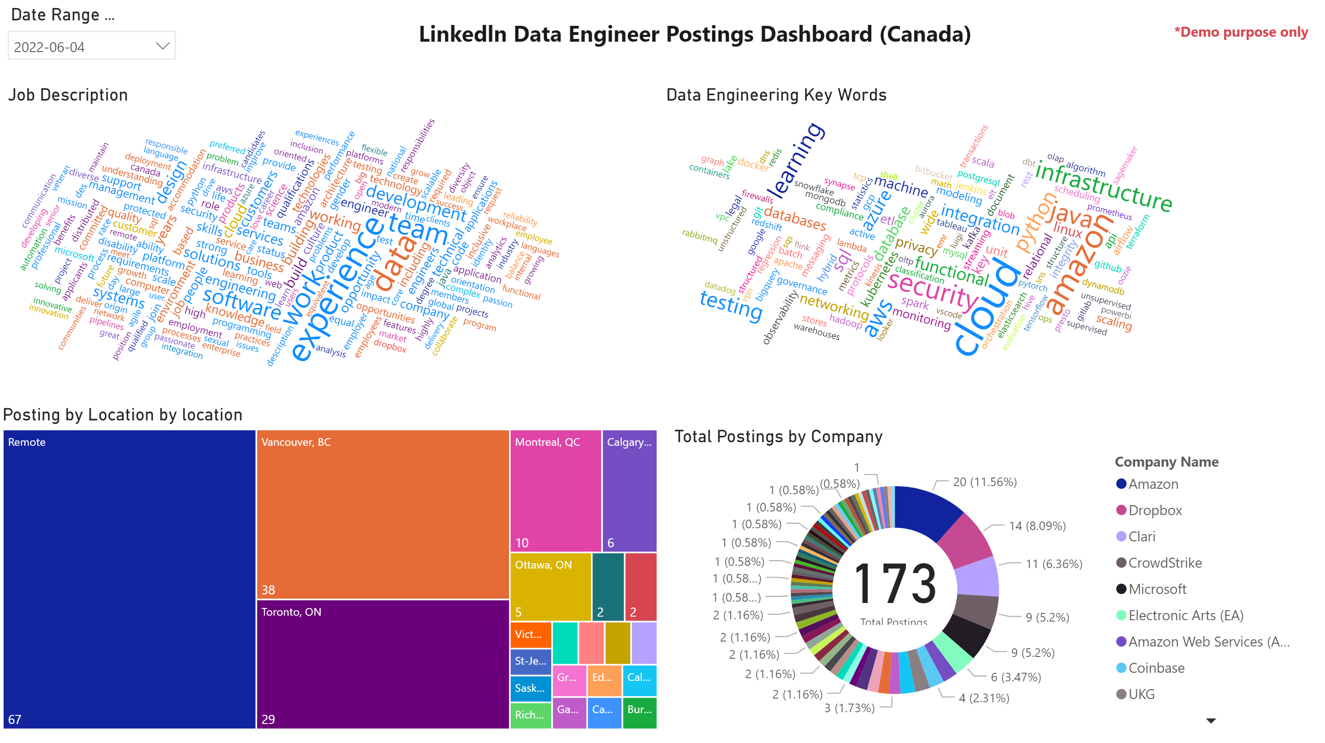
Live Demo

Slide 6
Future Improvements
Productionalize the data pipeline
The current data publisher lives on the same server as the airflow and has limited throughput. The script uses linkedin-jobs-scraper to scrape data from the webpage (Powered by Selenium). One can create a custom scraper that can concurrently scrape the pages and uses and dedicated compute resources server to host the scripts.
Improve Dashboard Output
The PowerBI dashboard generated here is quite basic for demo purposes. One can greatly improve this dashboard.
Testing
The data pipeline currently does not use any framework to test and validate the data. One can implement a testing framework such as Great Expectation to improve data quality and pipeline transparency.
Currently, airflow handles the creation, configuration, and termination of the EMR cluster at a spot price. However, this adds about 8 mins of overhead to the whole process. One can use a dedicated EMR cluster or create the cluster as the scraper runs to speed up this process.
The pyspark scripts only detect a limited amount of data engineering keywords. One can improve this list and get more meaningful visuals.
Use upsert for to store the final result to avoid potential duplicate records

Slide 7
Reference
How To Install Google Chrome, Selenium & Chromedriver For AWS EC2 Instances
linkedin-jobs-scraper 1.12.0
https://github.com/ABZ-Aaron/Reddit-API-Pipeline

